Slide 1
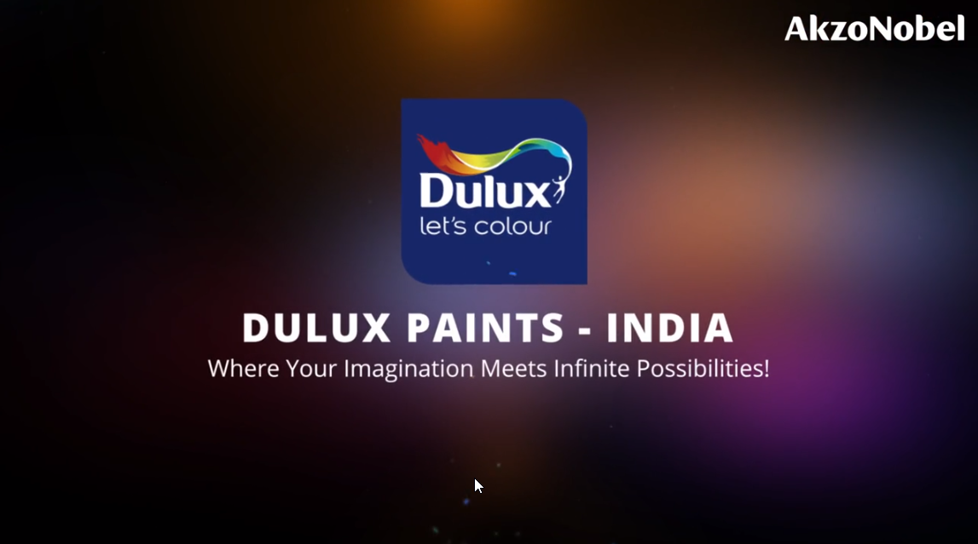
MALAYSIA
Notes:
VO:Welcome to the vibrant world of colors with Dulux Paints Malaysia where your imagination meets infinite possibilities. Click Start to begin.
Developer Notes: This is the standard starting animation that will play. Start button to be highlighted so that users knows he/she has to click it.

Slide 2
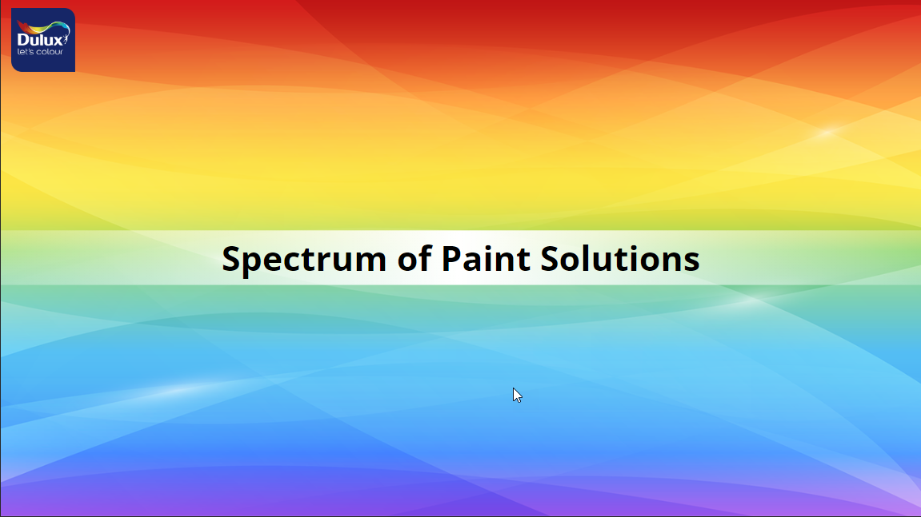
Notes:
VO: We offer a spectrum of paint solutions each catering to a specific needs and aesthetics.

Slide 3


INTERIOR PREMIUM WALL PAINT
INTERIOR MASS & ECONOMY WALL PAINT
EXTERIOR PREMIUM WALL & ROOF PAINT
EXTERIOR MASS WALL PAINT
TRIMS PREMIUM PAINT
TRIMS MASS PAINT
WATERPROO-FING PREMIUM PAINT
PRE DECO
Click each tile to know more about the specifics of that category
Notes:
Voiceover (VO): Our Categories include the following: (Animate the rectangles in sync with audio)
INTERIOR PREMIUM WALL PAINT
INTERIOR MASS & ECONOMY WALL PAINT
EXTERIOR PREMIUM WALL & ROOF PAINT
EXTERIOR MASS WALL PAINT
TRIMS PREMIUM PAINT
TRIMS MASS PAINT
WATERPROOFING PREMIUM PAINT
PRE DECO
OST: Click each tile to know more about the specifics of that category.
Developer Notes: The shapes should be clickable. Clicking the shape should take it to the respective section of the course. This should be open navigation, use can click any of the shapes first to begin. On Mouse hover, the colour of the shape should change and it should be highlighted. Once visited, there should be a tick mark on the shape to denote that it has already been viewed.

Slide 4
INTERIOR PREMIUM WALL PAINT
Notes:
Developer Notes: This section should be played when the user selected the tile Interior Premium Wall Paint.

Slide 5
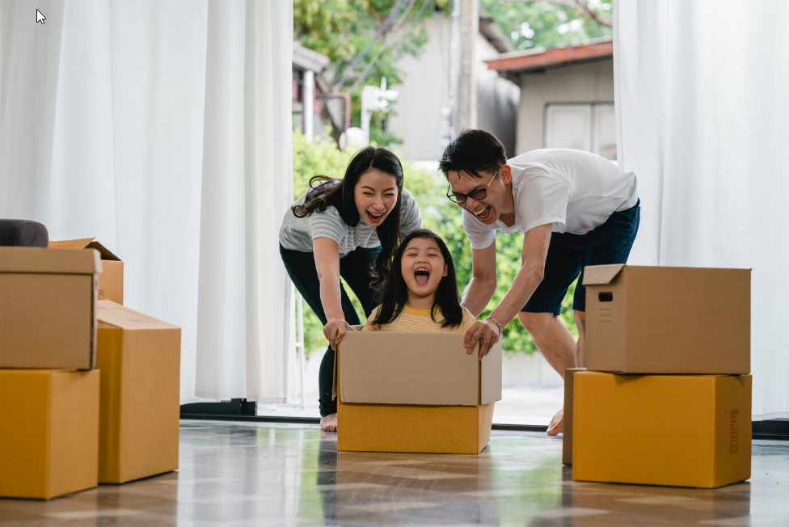

Introduction to scenario
Notes:
Photo link: https://www.freepik.com/free-photo/happy-asian-young-family-having-fun-laughing-moving-into-new-home-japanese-parents-mother-father-smiling-helping-excited-little-girl-riding-sitting-cardboard-box-new-property-relocation_6142472.htm#query=relocation%20malaysia&position=13&from_view=search&track=ais&uuid=317c2f39-0eda-4b93-8552-2dde1f0da1fb
Single boy: https://www.freepik.com/free-photo/portrait-cute-little-boy-standing-with-arms-folded-looking-camera_3175259.htm#query=asian%20toddler&position=6&from_view=search&track=ais&uuid=9d423f74-440a-4368-91ea-27177e11828a
VO: Ahmad and family are moving into their new home. They want their home to look stunning, colourful and a reflection of their personalities. Above all, they would like their home to be safe, easy to clean and stain resistant. Ahmad has a wide variety of paints and colours to choose from, lets help him to select the best option for his needs.
Notes to developer: Need to do a slow zoom in this image while the voice over is being narrated.

Slide 6
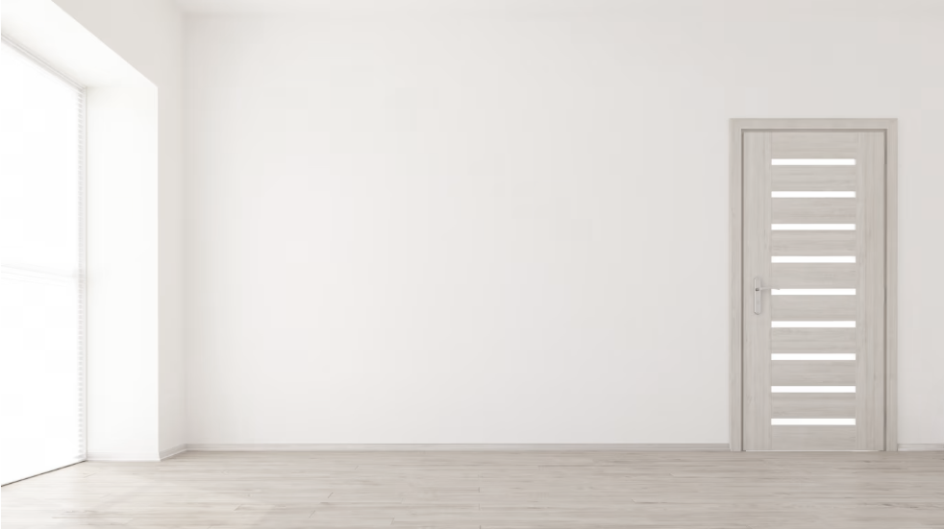
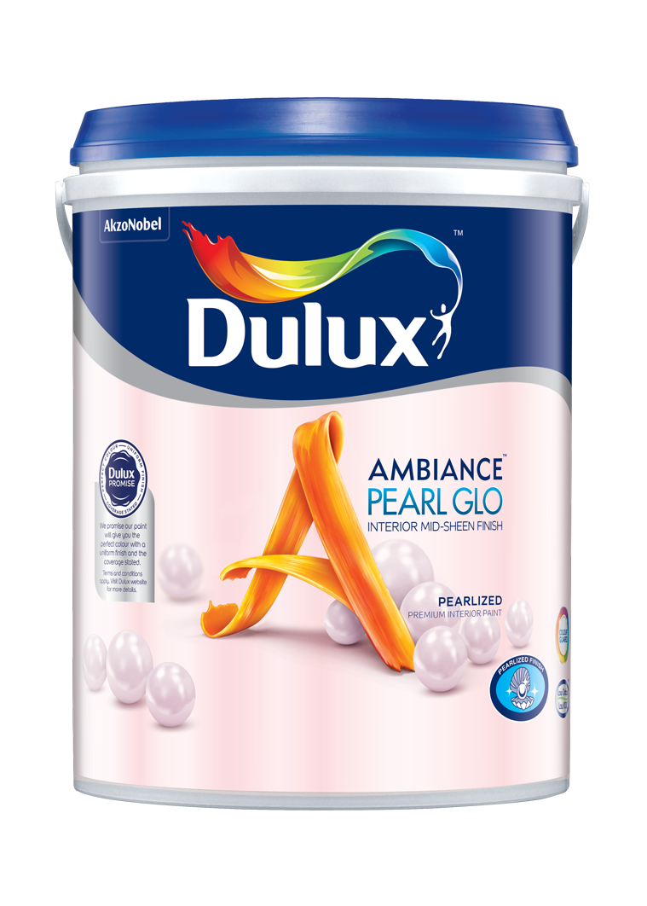
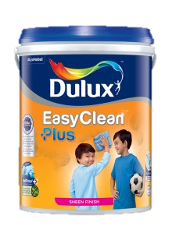
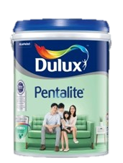
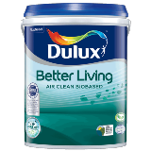
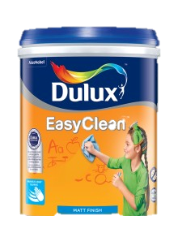


INTERIOR PREMIUM WALL PAINT
Dulux Better Living Air Clean Biobased
Dulux Ambiance Pearl Glo
Dulux EasyClean Plus /EasyClean
Dulux Pentalite
I’m confused, how do I choose the best paint for me?
Notes:
VO: Dulux offers a variety of solutions for all kinds of needs.
Let's help Ahmad select the right kind of paint to customize each of their rooms in their new home. (The thought bubble appears after the paints are displayed one by one)
OST: Click on each type to learn more.
Image referece:1. https://www.freepik.com/free-photo/3d-render-empty-room-interior_5027779.htm#query=new%20home%20empty&position=14&from_view=search&track=ais&uuid=3d7d3747-a661-4529-80e0-83bfd7f478da (background)
2. https://www.freepik.com/free-photo/pensive-man-eyeglasses-looking-aside_7370466.htm#query=asian%20man%20glasses&position=18&from_view=search&track=ais&uuid=8d52b750-945b-4792-97a7-d252abbb4084
(Asian Man thinking keywords)

Slide 7
INTERIOR PREMIUM WALL PAINT
Dulux Better Living Air Clean Biobased
Dulux Ambiance Pearl Glo
Dulux EasyClean Plus /EasyClean
Dulux Pentalite
Notes:
VO: Dulux offers a variety of solutions for all kinds of needs.
Let's help Ahmad select the right kind of paint to customize each of their rooms in their new home.
OST: Click on each type to learn more.
Image referece:1. https://www.freepik.com/free-photo/3d-render-empty-room-interior_5027779.htm#query=new%20home%20empty&position=14&from_view=search&track=ais&uuid=3d7d3747-a661-4529-80e0-83bfd7f478da (background)
2. https://www.freepik.com/free-photo/pensive-man-eyeglasses-looking-aside_7370466.htm#query=asian%20man%20glasses&position=18&from_view=search&track=ais&uuid=8d52b750-945b-4792-97a7-d252abbb4084
(Asian Man thinking keywords)

Slide 8
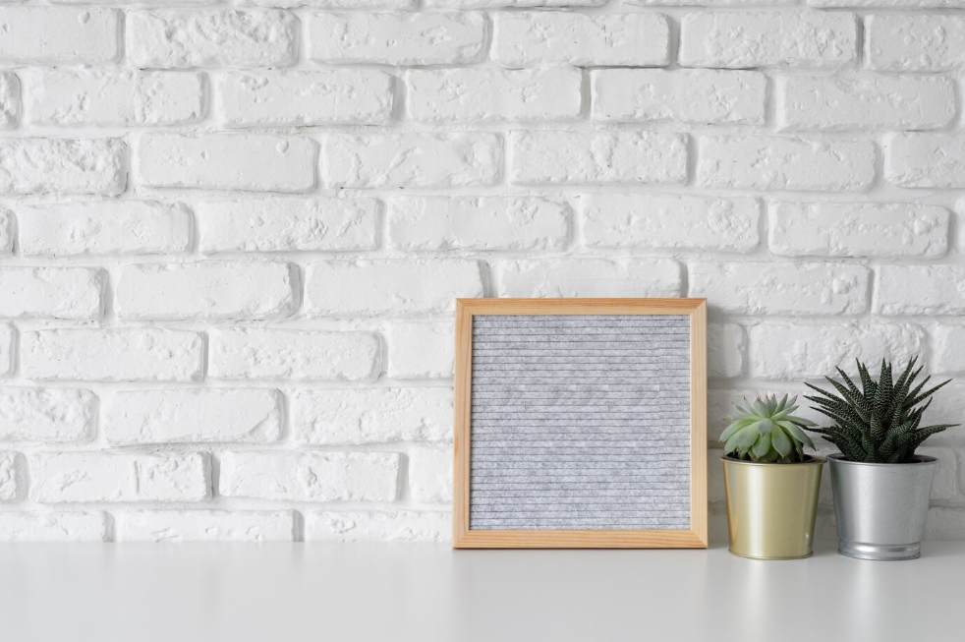
Introduction
Dulux Better Living Air Clean Biobased
Notes:
VO: Dulux Better Living has a unique PureAir technology that uses biobased ingredients and this property allows it to purify indoor air. It does this by reducing harmful impact of formaldehyde and other VOCs. Let’s see how this is the perfect solution for Ahmads living room.
Image: https://www.freepik.com/free-photo/creative-inspirational-resource_19869962.htm#query=blank%20brick%20wall%20with%20a%20table&position=27&from_view=search&track=ais&uuid=c123f59f-07f7-45ad-ae22-655b8ebea06e

Slide 9
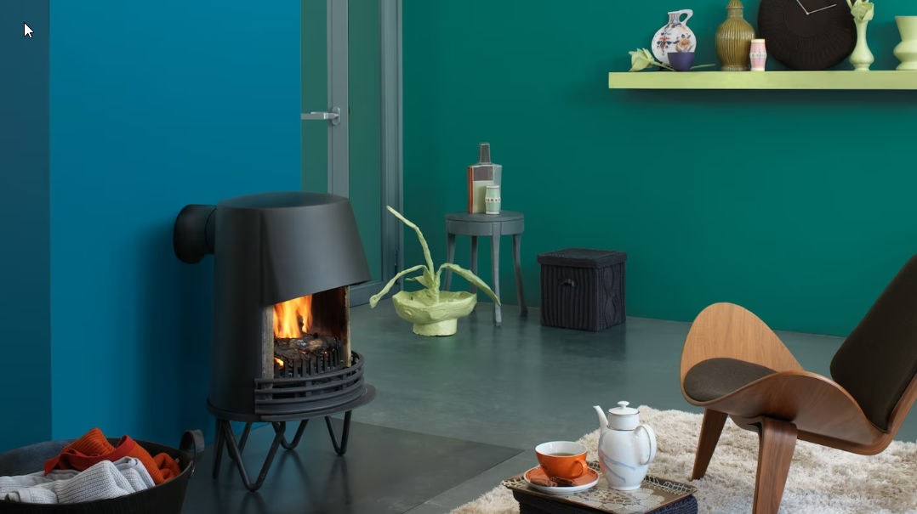

Problem Statement:
Click this thought bubble to see Ahmad’s thought.
Notes:
OST: Click this thought bubble to see what Ahmad is thinking.
VO: 1. Ahmad wants his living room to be airy, fresh and with natural elements. He also wants the paint to be environmentally friendly and help with maintaining proper air quality inside the living room.
Image Ref: https://www.freepik.com/free-photo/minimalist-interior-design_72291465.htm#from_view=detail_serie
Character photo ref: https://www.freepik.com/free-photo/young-asia-businessman-using-computer-laptop-talk-colleagues-about-plan-video-call-meeting-while-working-from-home_14323589.htm#&position=6&from_view=author&uuid=1d496521-9dcc-4a6f-9e7f-20a9bc6c566f

Slide 10
Benefits
USDA Certified
Cleans the air
Natural ingredients and environmentally friendly
Notes:
VO: (plays after paint can is shown). The Dulux Better Living series of paints is USDA certified and it helps clean the internal air by removing hamful impacts of formaldehyde and other Volatile Organic Compounds (commonly called VOCs). Also, it is made using naturally occurring ingredients such as active bamboo charcoal and is therefore environmentally friendly too. This is perfect as per Ahmad’s requirements.
Animation Description: Bring an image of the Dulux Better Living sliding from right side into the frame. Character expression should change from being thoughtful to smiling once the paint image is shown. The 3 bullet points should be displayed in synchronisation with the spoken audio.
Image Ref: https://www.freepik.com/free-photo/minimalist-interior-design_72291465.htm#from_view=detail_serie
Character photo ref: https://www.freepik.com/free-photo/young-asia-businessman-using-computer-laptop-talk-colleagues-about-plan-video-call-meeting-while-working-from-home_14323589.htm#&position=6&from_view=author&uuid=1d496521-9dcc-4a6f-9e7f-20a9bc6c566f

Slide 11
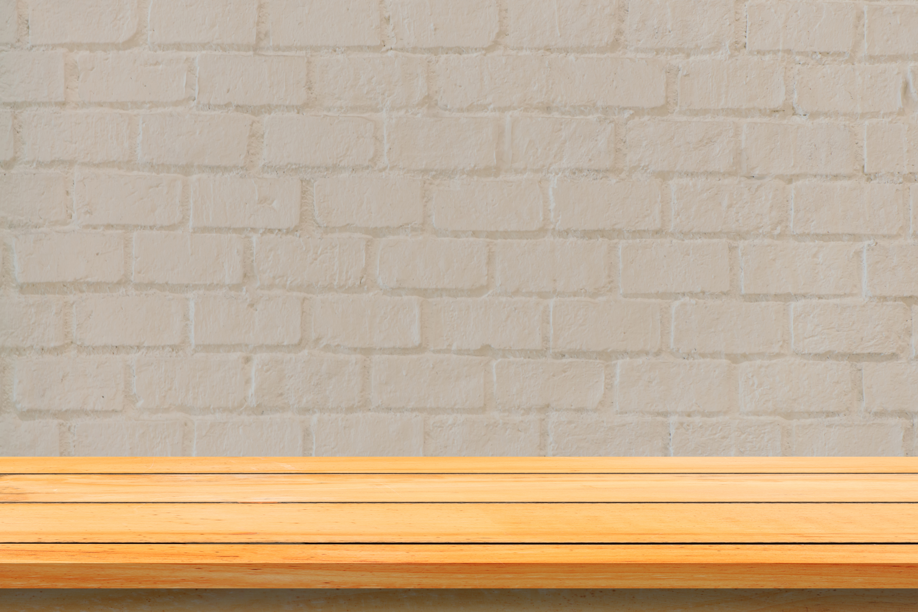
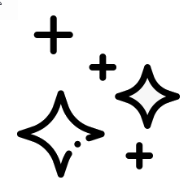





Features
Coverage: 11-12 mt²/Lt
mts²
Finish: Sheen
Drying time:
2-3 hrs
Anti Bacterial
>1200 shades
Water based
1L, 5L buckets
Click the product to learn more.
Notes:
VO: Let's now unlock some extraordinary features that set Dulux Better Living. Click the product to learn more.
Water based environmentally friendly.
Anti bacterial and anti fungal properties
Finishes with a good sheen and luster
Cover more space with less paint, with 11-12 square meters per liter.
Quick drying time of 2-3 hours.
Choose from over 1200 soft pastel colors to personalize your space.
Available in 2 sizes, which are1L, 5L buckets.
Developer Notes
Show OST in sync with the VO (User needs to click only once, and the icons appear one after the other in sync with audio)
Icon references:
Water Based Icon: https://www.flaticon.com/free-icon/water-drop_3105761?term=water&page=1&position=2&origin=search&related_id=3105761
Anti bacterial: taken from previous SB (India specific SB)
Shine: https://www.flaticon.com/search?word=shine
Coverage: Created by Me
Time: taken from PPT icons
Colors: Taken from previous India SB
Paint can: https://www.flaticon.com/free-icon/paint-can-open_81980?term=paint+cans&page=1&position=3&origin=search&related_id=81980
Paint quantity: Created by me using above paint can and scale created myself.

Slide 12
Result :
Notes:
As a result, Ahmad has his living room painted in environmentally friendly and safe colors.
Developer Notes
Show Ahmad looking happy. He has fresh walls with clean air.
Image links: https://www.freepik.com/free-photo/minimalist-interior-design_72291465.htm#from_view=detail_serie

Slide 13
INTERIOR PREMIUM WALL PAINT
Dulux Better Living Air Clean Biobased
Dulux Ambiance Pearl Glo
Dulux EasyClean Plus /EasyClean
Dulux Pentalite
Notes:
Developer Notes: Imagine the user wants to select the second option here which is Dulux Ambiance Pearl Glo.

Slide 14
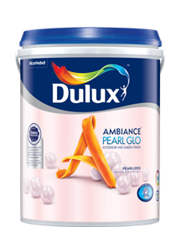
Introduction – Ambiance Pearl Glo
Dulux Ambiance Pearl Glo
Notes:
VO: Dulux Ambiance Pearl Glo has an attractive pearlized mid-sheen finish provides a timeless & elegant look to your room.
Image: https://www.freepik.com/free-photo/creative-inspirational-resource_19869962.htm#query=blank%20brick%20wall%20with%20a%20table&position=27&from_view=search&track=ais&uuid=c123f59f-07f7-45ad-ae22-655b8ebea06e

Slide 15

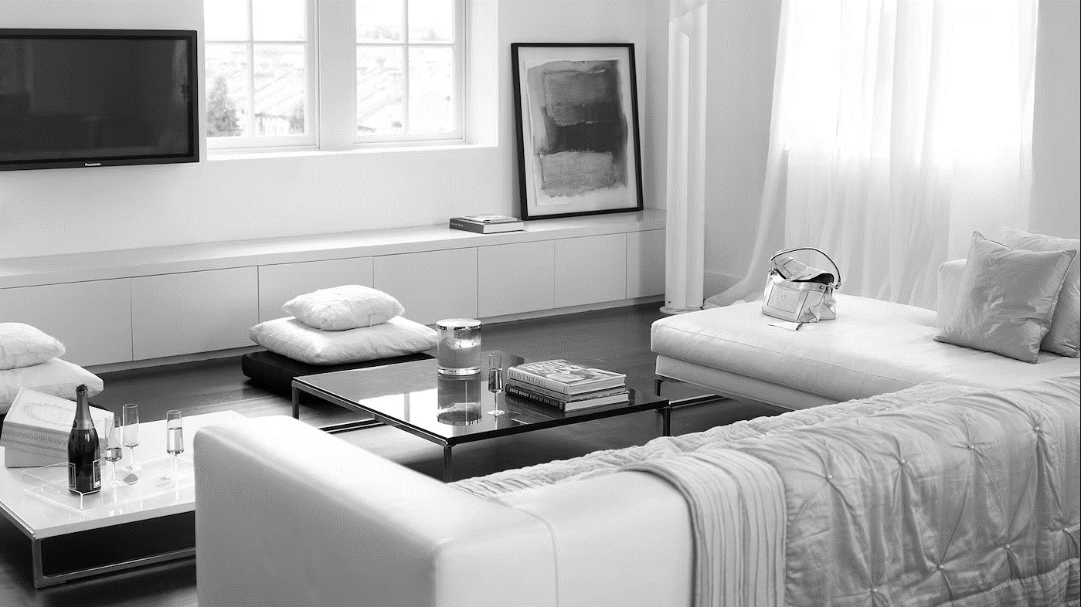
Click this thought bubble to see Ahmad’s thought.
Problem Statement:
Notes:
VO: Ahmad wants to show off his new house to all his friends and relatives. He wants it to have a contemporary style with latest trendy colours and an attractive interiors. He would like the best paints to be used in his dining area. Let’s see how Dulux Ambiance Pearl Glo is the best choice for this needs.
Image ref: https://images.akzonobel.com/akzonobel-flourish/dulux/in/dulux/en/articles/channel-modern-luxury-shades-ivory/channel-modern-luxury-with-shades-of-ivory_2.jpg?impolicy=.auto&imwidth=1366
Person Image: https://www.freepik.com/free-photo/expressive-young-guy-posing-studio_16925389.htm#&position=11&from_view=author&uuid=5957b8f4-ad4f-41bc-9352-ea2e062fa5df

Slide 16

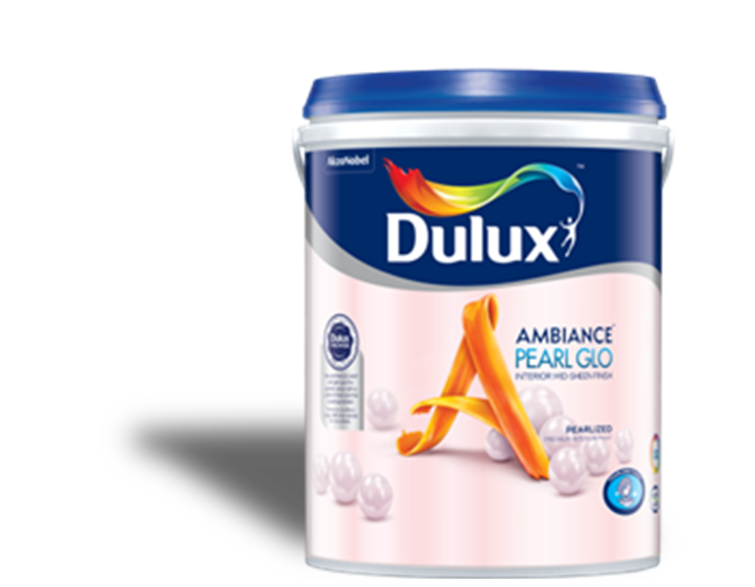
Benefits
Pearlized Mid Sheen
Long Lasting colours
Notes:
VO: (plays after paint can is shown). The Dulux Ambiance Pearl Glo is a unique offering that has a pealy mid-sheen finish. It gives a timeless look and is a long lasting paint.
Animation Description: Bring an image of the Dulux Ambiance sliding from left side into the frame. Character expression should change from previous slide. The 2 bullet points should be displayed in synchronisation with the spoken audio.
Character: https://www.freepik.com/free-photo/expressive-young-male-posing-studio_16925419.htm#&position=1&from_view=author&uuid=5957b8f4-ad4f-41bc-9352-ea2e062fa5df

Slide 17
Features
Coverage: 11-12 mt²/Lt
Drying time:
2-3 hrs
mts²
Finish: Pearlized Mid Sheen
>2500 shades
Water based
1L, 5L & 18 L
Click the product to learn more.
Notes:
VO: Let's now unlock some extraordinary features that set Dulux Ambiance Pearl Glo. Click the paint icon to learn more.
Water based environmentally friendly.
Finishes with a pearly mid-sheen finish
Cover more space with less paint, with 11-12 square meters per liter.
Quick drying time of 2-3 hours.
Choose from over 2500 colors to choose from.
Available in 2 sizes, which are1L, 5L & 18L buckets.

Slide 18

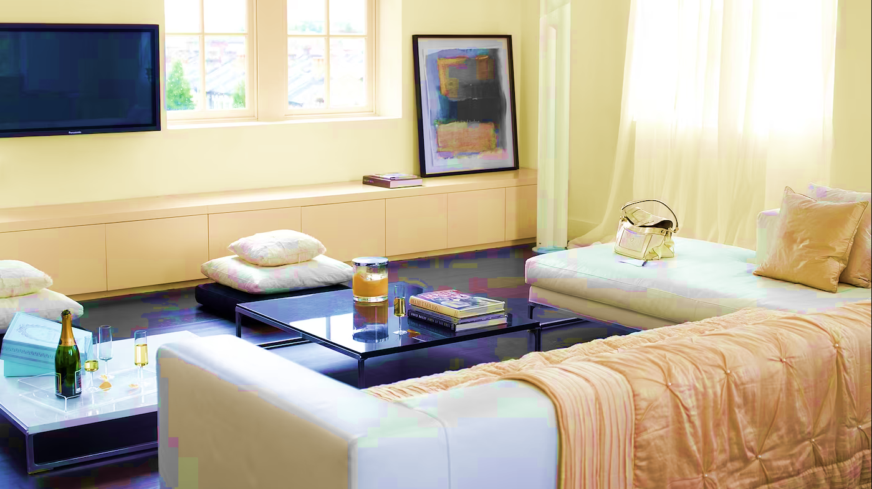
Results
Notes:
As a result, Ahmad has his living room painted in an attractive and long lasting paint coating with a timeless look.
Developer Notes
Show Ahmad looking happy. His living room looks timeless and elegant.
Image Ref: https://www.freepik.com/free-photo/expressive-young-guy-posing-studio_16925350.htm#&position=3&from_view=author&uuid=5957b8f4-ad4f-41bc-9352-ea2e062fa5df#position=3

Slide 19
INTERIOR PREMIUM WALL PAINT
Dulux Better Living Air Clean Biobased
Dulux Ambiance Pearl Glo
Dulux EasyClean Plus /EasyClean
Dulux Pentalite

Slide 20
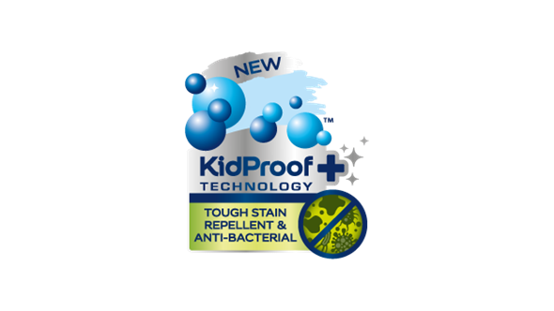
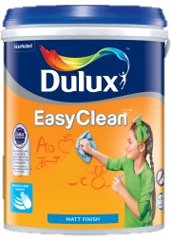
Introduction
Dulux EasyClean Plus and
Dulux EasyClean
Notes:
VO: Dulux Easy Clean and Easy Clean Plus are two products which are don’t allow common household stains from penetrating into the paint. They can be easily wiped away, leaving walls looking fresh and clean. They have colour guard technology and Kidproof+ technology (EasyClean Plus) which keep walls looking clean and fresh for years.
Image: https://www.freepik.com/free-photo/creative-inspirational-resource_19869962.htm#query=blank%20brick%20wall%20with%20a%20table&position=27&from_view=search&track=ais&uuid=c123f59f-07f7-45ad-ae22-655b8ebea06e

Slide 21
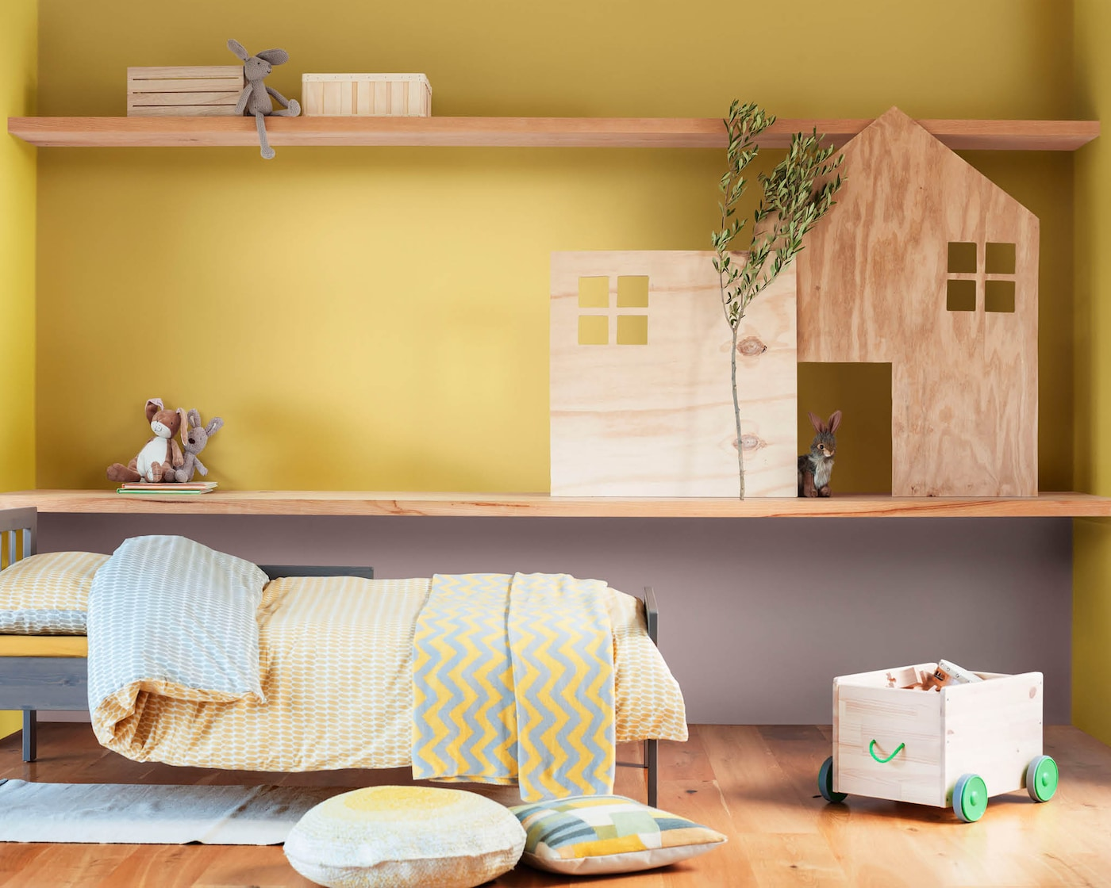
Notes:
VO: Maria and Ahmad are parents of two children aged 6 and 3. These little artists are fond of creating artwork everywhere including the walls in the house. Maria and Ahmad are looking for a solution where their walls look beautiful and yet are washable and easy to clean. Let us see what Dulux has to offer them in making their kids rooms vibrant and colourful.
Image Ref: https://images.akzonobel.com/akzonobel-flourish/dulux/in/dulux/en/articles/4-ways-transform-childs-bedroom-dulux-colour-year-2018/cf18_coty_kids_rooms_2048x1638_3_1.jpg?impolicy=.auto&imwidth=1366

Slide 22
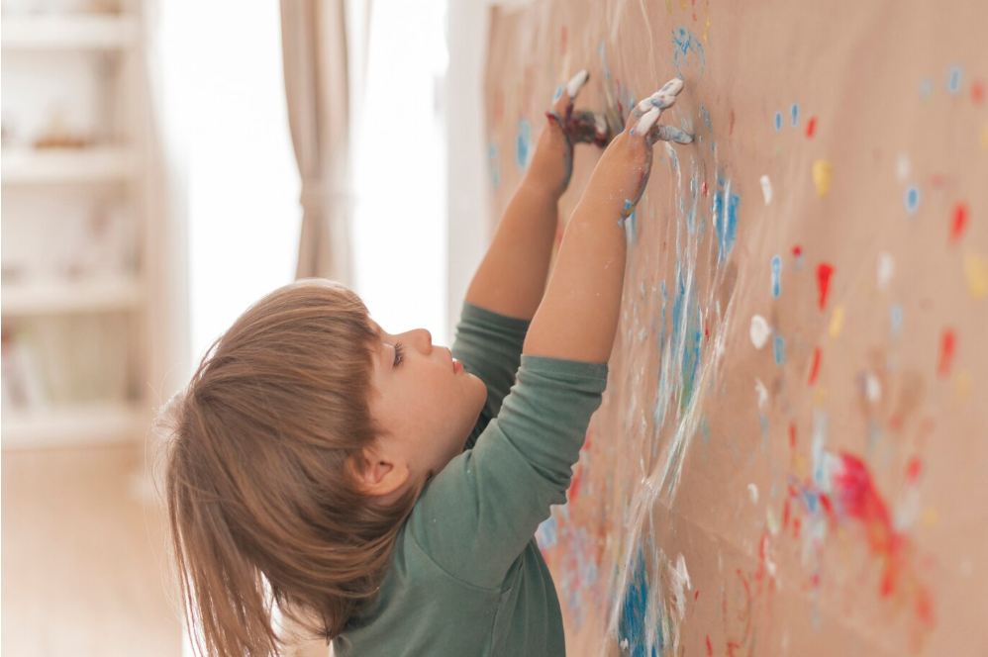
Problem Statement:
Notes:
VO: Maria and Ahmad are afraid that their children might accidently damage the paint in their new house. However, they do not want to be too harsh on their children too. They are wondering if there is any Child proof paint options available to paint their childrens room. Let’s check what Dulux has to offer them in this situation.
Image Ref: https://www.freepik.com/free-photo/little-child-painting-like-artist_4653983.htm#page=3&query=asian%20kid%20painting%20walls&position=2&from_view=search&track=ais&uuid=612b4766-1cba-4e6f-978c-f674f0fb95f3

Slide 23
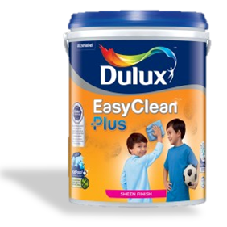
Benefits
Sheen Finish
Matt Finish
Kidproof+ technology
ColourGuard Technology, Easy Cleaning Function
Antibacterial and
Anti virus protection
Antibacterial protection
Notes:
VO: (plays after paint can is shown). The Easy Clean Plus range comes in either a Sheen finish and has advanced Kidproof+ technology in it. It allows for easy cleaning of stains, and also protects against bacteria and viruses. While the EasyClean range comes with ColourGuard Technology. This makes walls resistant to permanent stains by having easy to clean properties. This ensures that walls remain looking fresh and clean for longer periods as compared to traditional paint finished.
Animation Description: Bring an image of the Dulux Ambiance sliding from left side into the frame. The two sets of 3 bullet points should be displayed in synchronisation with the spoken audio.

Slide 24
Coverage: 11-12 mt²/Lt
Features
mts²
Anti Bacterial
Drying time:
2-3 hrs
Finish: Sheen / Matt
>2500 shades
Water based
1L, 5L & 18 L
Click the product to learn more.
Notes:
VO: Let's now unlock some extraordinary features that set Dulux Easy Clean and EasyClean Plus. Click each icon to learn more.
Water based environmentally friendly.
Anti bacterial and anti fungal properties
Finishes with a sheen for Dulux EasyClean Plus and a matt finish for the Dulux Easy Clean.
Cover more space with less paint, with 11-12 square meters per liter.
Quick drying time of 2-3 hours.
Choose from over 1200 soft pastel colors to personalize your space.
Available in 2 sizes, which are1L, 5L buckets.

Slide 25
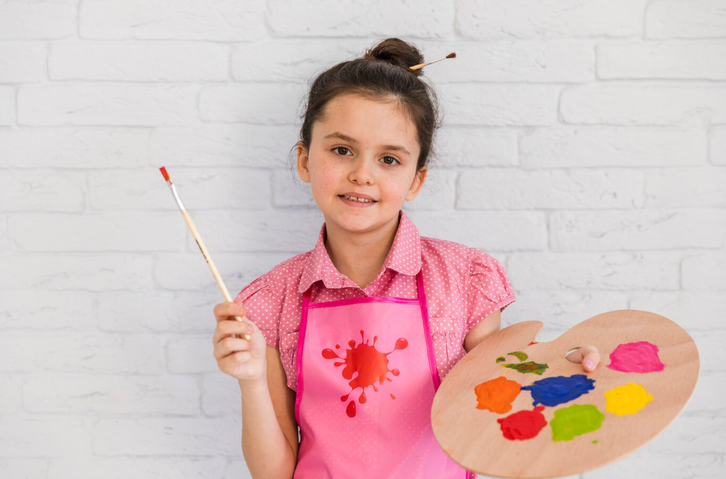
Results
Notes:
VO: Thanks to Dulux’s Dulux EasyClean Plus and Dulux EasyClean products, Maria and Ahmad can be assured that their children have the freedom to have fun, and their walls will also stay fresh and clean.
Image Reference: https://www.freepik.com/free-photo/smiling-portrait-girl-standing-against-white-brick-wall-holding-paintbrush-colorful-palette_4142123.htm#page=4&query=asian%20kid%20painting%20walls&position=13&from_view=search&track=ais&uuid=612b4766-1cba-4e6f-978c-f674f0fb95f3

Slide 26
INTERIOR PREMIUM WALL PAINT
Dulux Pentalite
Dulux Better Living Air Clean Biobased
Dulux Ambiance Pearl Glo
Dulux EasyClean Plus /EasyClean

Slide 27
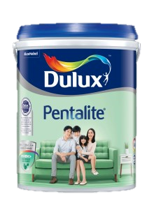
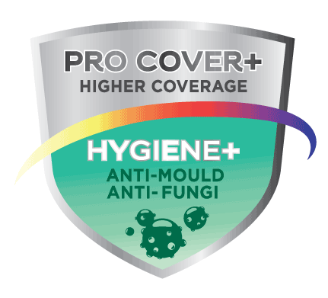
Introduction
Dulux Pentalite
Notes:
Dulux Pentalite contains unique ProCover+ & Hygiene+ ingredients that give it ability to combat disease causing mould & fungus. This helps keep your homes protected and looking good and also cares for your family’s health at the same time.

Slide 28
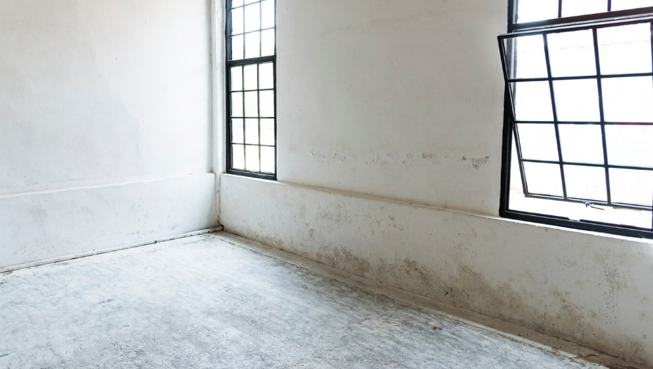

Problem Statement:
Damp walls, fungal infections, sick kids…
Notes:
VO: Due to the Prescence of dampness in walls and ceilings, mould and fungus appear that not only spoils the look of the house but also is harmful to health. Maria is worried about the health and wellbeing of her children and her family and wants to safeguard them against any infections that may occur due to dampness and fungi.
Worried looking Maria is thinking about potential damage being caused by dampness and other bacterial infections.
Image links:
https://www.freepik.com/free-photo/clean-windows-empty-white-house-blank_3012151.htm#query=dull%20and%20damaged%20interior%20walls&position=36&from_view=search&track=ais

Slide 29
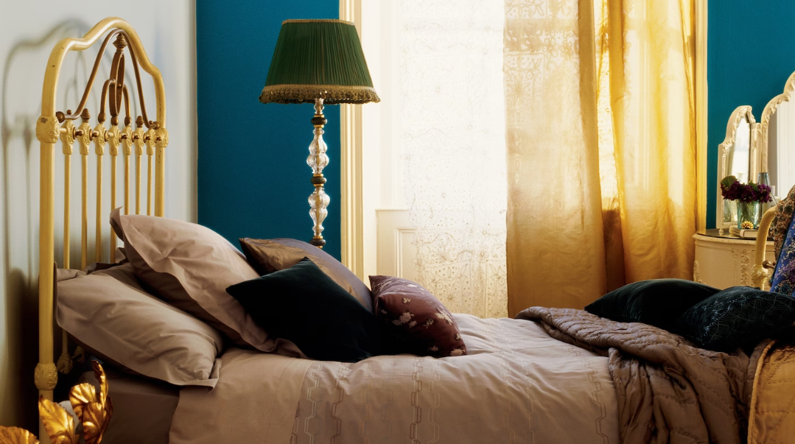
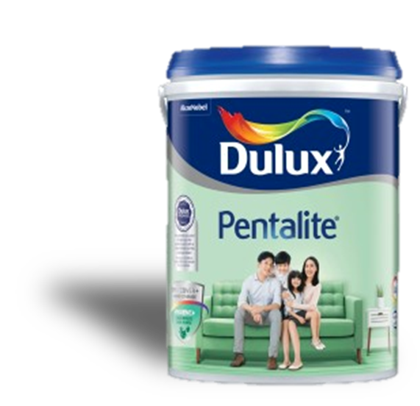
Benefits
Hygiene+ properties
ProCover+ protection
Antibacterial and
Anti virus protection
Notes:
VO: (plays after paint can is shown). The Dulux Pentalite has Hygiene+ properties and ProCover+ Protection in it. The anti-mould & fungal protect your loved ones from pathogens and also keep your walls from showing damp patches which spoil the look of your home. You get a happy healthy and good looking home with Dulux Pentalite.
Animation Description: Bring an image of the Dulux Pentalite sliding from left side into the frame. The two sets of 3 bullet points should be displayed in synchronisation with the spoken audio.
Image Ref: https://www.dulux.in/en/colour-inspiration/inject-shot-glamour-deep-teal

Slide 30
Features
Coverage: 11-12 mt²/Lt
Features
mts²
Anti Bacterial
Drying time:
2-3 hrs
Finish: Sheen / Matt
>2500 shades
Water based
1L, 5L & 18 L
Click the product to learn more.
Notes:
VO: Let's now check some extraordinary features of this product.
Water based environmentally friendly.
Finishes with a sheen for Dulux EasyClean Plus and a matt finish for the Dulux Easy Clean.
Anti bacterial and anti fungal properties
Cover more space with less paint, with 11-12 square meters per liter.
Quick drying time of 2-3 hours.
Choose from over 2500 shares
Available in 2 sizes, which are1L, 5L and 18 Ltr buckets.

Slide 31

Results
Notes:
VO: Maria is very happy with the choice of Dulux Pentalite. She does not need to worry about damp walls or her family being affected by pathogens either. Her walls are protected and so is her family.
Image Ref: https://www.dulux.in/en/colour-inspiration/inject-shot-glamour-deep-teal
Image woman: https://www.freepik.com/free-photo/happy-mixed-race-woman-has-cheerful-expression-points-away-with-both-fore-fingers-says-follow-there-shows-direction-copy-space-wears-denim-clothes-white-hijab-isolated-purple-wall_11577707.htm#query=Malaysian%20woman&position=37&from_view=search&track=ais&uuid=1311889a-75c2-4715-b67f-59161586acbf

Slide 32
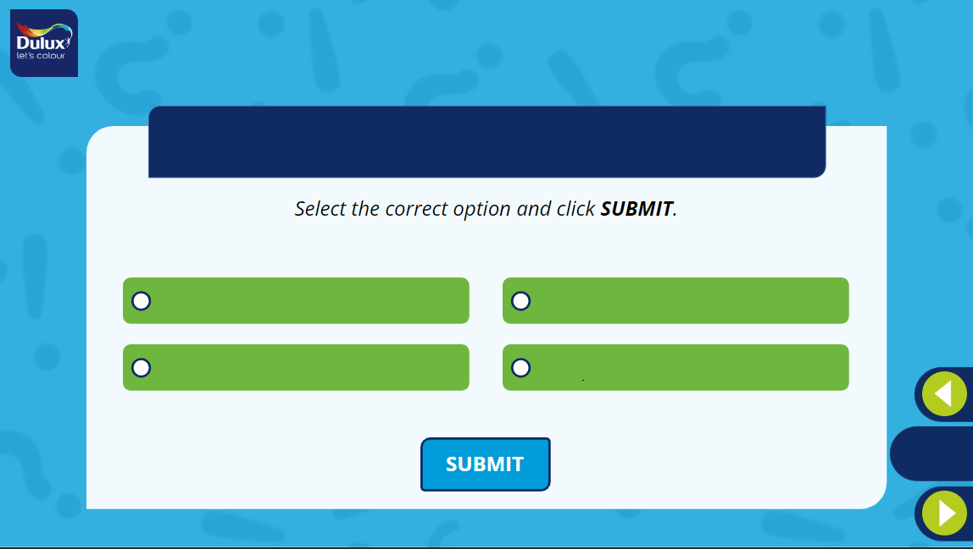
What is the unique thing about the Dulux Better Living Air Clean Biobased paints?
1
2
It has bio luminance property which makes it glow in the dark
It cleans the environment when applied to external surfaces
3
4
It has the highest sheen of all products
It has biobased ingredients which enable it to purify indoor air
Notes:
Developer Notes: Option 4 is the correct option.

Slide 33
What is the difference between the Dulux EasyClean and EasyClcean Plus?
Select all the options that apply and click SUBMIT.
(More than one option may be correct)
1
2
EasyClean Plus: Sheen Finish
EasyClean : Matt Finish.
EasyClean Plus: Solvent Based
EasyClean : Water Based.
3
4
EasyClean Plus: Kidproof+ technology
EasyClean : ColourGuard technology.
EasyClean Plus: Hard to clean
EasyClean: Hard to clean
Notes:
Developer Notes: Option1 and Option 3 are the correct options.

Slide 34
INTERIOR MASS & ECONOMY WALL PAINT

Slide 35
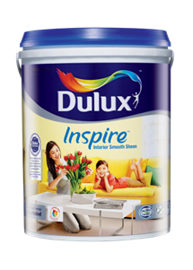
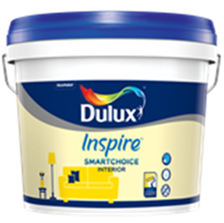
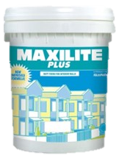
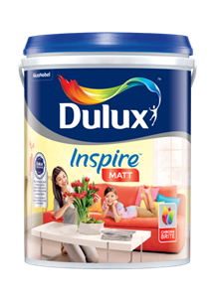
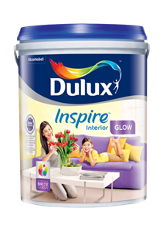
INTERIOR MASS & ECONOMY WALL PAINT
Dulux Inspire Interior – Smooth Sheen
Dulux Inspire SmartChoice Interior
Dulux Inspire Interior – Matt
Dulux Pentalite
Dulux Inspire Interior – Glow
Notes:
VO: We will now view the INTERIOR MASS & ECONOMY WALL PAINT range offered by DULUX. Click any of the products on the page to know more about it.

Slide 36
INTERIOR MASS & ECONOMY WALL PAINT
Dulux Inspire Interior – Smooth Sheen
Dulux Inspire SmartChoice Interior
Dulux Inspire Interior – Matt
Dulux Maxlite Plus
Dulux Inspire Interior – Glow
Notes:
Selected product: Dulux Inspire Interior – Glow.

Slide 37
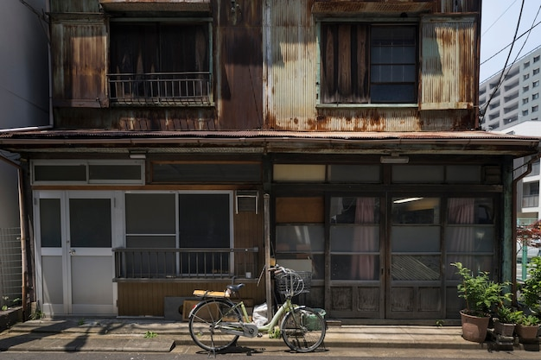

Overall Problem Statement
Ground Floor Hallway
Bedroom 1
Bedroom 2
Living Room
Attic
Notes:
VO: Bintang and his cousins Johan and Adelia live in their uncles small house in the southern part of the city. With the approaching festivals, they want to surprise their uncle by painting his house for him. They are looking for options to give their rooms and common areas a nice makeover. The top floor is especially in need of some repair. They want a high quality finish on a budget and are looking for options. Let’s see how Dulux’s range of paints can help them.
Click the different rooms to see the different requirements.
Image Ref:
BG: https://www.freepik.com/free-photo/haunted-house-bicycle-background_28421132.htm#page=2&query=poor%20asian%20house&position=47&from_view=search&track=ais&uuid=910811ea-b5e4-4fc0-83e3-dbe6f372a9a2
Group: Image Ref: https://www.freepik.com/free-photo/medium-shot-smiley-friends-wearing-trucker-hats_26502258.htm#query=asian%20group%20of%20youngsters%20poor&position=45&from_view=search&track=ais&uuid=b316944a-c41b-4f54-a1b7-7de81b1bcf7a

Slide 38
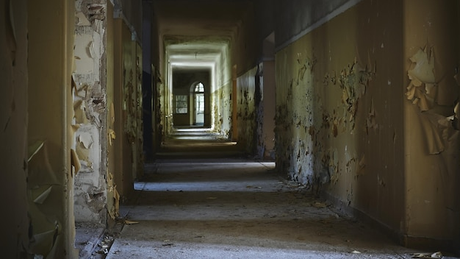
Ground Floor Hallway
Ground Floor Hallway
Notes:
VO: The hallway is always used by everyone living in the household. Walls get dirty quicker with smudges, hand prints and other stains. Dulux Inspire Interior – Glow is a perfect solution for this, as it offers a washable, high sheen paint finish at a budget. Click Next to proceed.
Image Ref: https://www.freepik.com/free-photo/hallway-abandoned-building-with-aged-walls-lights_10728678.htm#query=malaysian%20house%20hallway%20dirty&position=10&from_view=search&track=ais&uuid=070be648-0ee5-4d8f-ac6d-3d8895f3f752

Slide 39
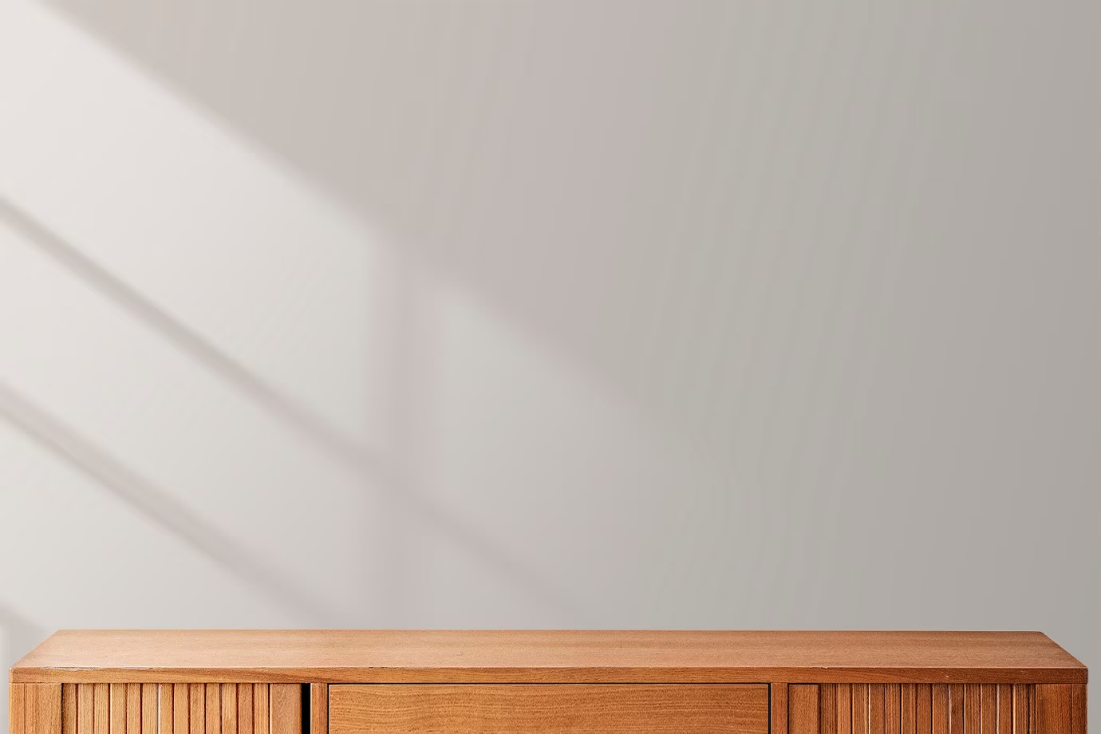
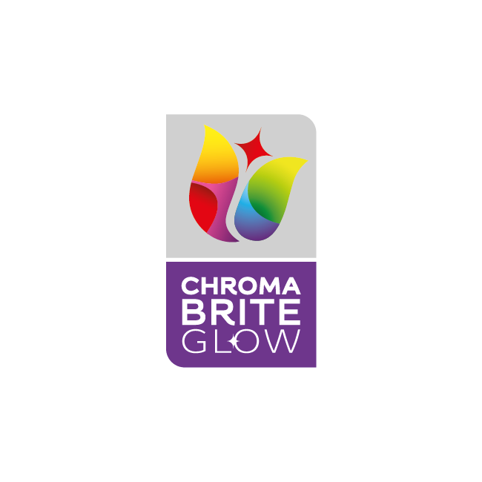
Introduction
Dulux Inspire Interior – Glow
ChromaBrite technology
High Sheen
Long lasting protection
Notes:
VO: Dulux Inspire Interior – Glow is a perfect solution for this, as it offers a washable, high sheen paint finish at a budget.
Image Ref: https://www.freepik.com/free-photo/minimal-product-backdrop-with-wooden-cabinet_15667366.htm#query=wall%20with%20shelf&position=45&from_view=search&track=ais&uuid=03401b9d-5e02-493a-b83e-86ac6b56b47b

Slide 40
Features
Good Opacity
1 Ready mix
>2500 shades
Coverage:
10-11 mt²/Lt
mts²
Finish: High Sheen
1L, 5L & 18 L
Click the product to learn more.
Notes:
VO: Let's now check some extraordinary features of this product.
Finishes with a High sheen
Cover more space with less paint, with 10-11 square meters per liter.
Good Opacity to cover imperfections
Choose from over 2500 shares with a single ready mix
Available in 1, 5 and 18 litre packaging

Slide 41
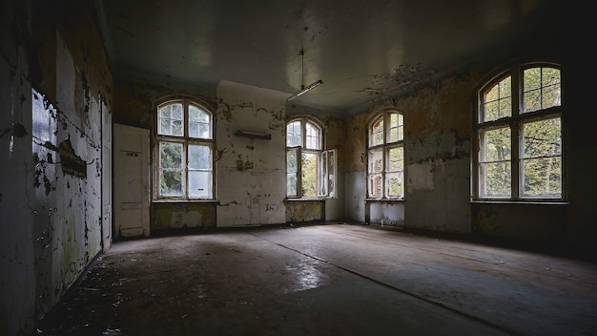
Living Room
Notes:
VO: The Living room needs a nice makeover. Everyone spends their free time here. Bintang thinks that they need the living room to be bright, colourful and have smooth shiny walls.
Click Next to proceed.
Image Ref: https://www.freepik.com/free-photo/beautiful-view-interior-old-abandoned-building_13292407.htm#query=dirty%20chinese%20living%20room&position=43&from_view=search&track=ais&uuid=839cf31f-de8a-433d-a2f1-3c368f10201a#position=43&query=dirty%20chinese%20living%20room

Slide 42

Introduction
Dulux Inspire Interior – Smooth Sheen
ChromaBrite technology
Mid Sheen finish
Long lasting protection
Notes:
VO: Dulux Inspire Interior – Smooth Sheen offers a mid sheen finish with chromabrite technology to offer long lasting protection. It is another washable paint that is cost effective too.

Slide 43
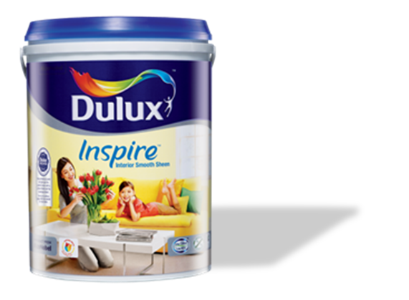
Features
Good Opacity
1 Ready mix
>2200 shades
Coverage:
10-11 mt²/Lt
mts²
Finish: Mid Sheen
1L, 5L & 18 L
Click the product to learn more.
Notes:
VO: Let's now check some extraordinary features of this product.
Finishes with a High sheen
Cover more space with less paint, with 10-11 square meters per liter.
Good Opacity to cover imperfections
Choose from over 2200 shares with a single
Available in 1, 5 and 18 litre packages.
Image Ref: https://www.freepik.com/free-photo/minimal-product-backdrop-with-wooden-cabinet_15667366.htm#query=wall%20with%20shelf&position=45&from_view=search&track=ais&uuid=03401b9d-5e02-493a-b83e-86ac6b56b47b

Slide 44
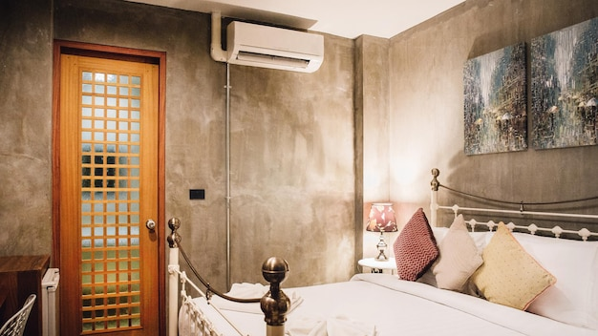
Bedroom 1
Notes:
The bedroom walls appear dull and dirty with years of usage and stains. This is Johans bedroom and he wants to have a matt finish to adorn these walls. Can you guess which would be the correct paint choice for him? Let’s take a look. Click next to proceed.
Image Ref: https://www.freepik.com/free-photo/interior-hotel-room-residence-is-furnished-modernly-copy-space-background_21849064.htm#page=2&query=indonesia%20bedroom%20dirty&position=43&from_view=search&track=ais&uuid=d7c87e93-c5ba-4862-9294-aff898032553

Slide 45
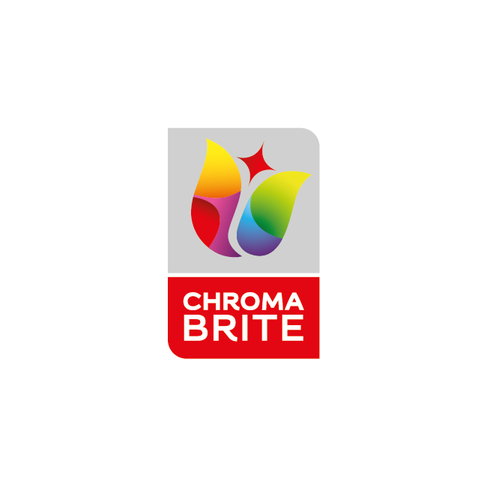
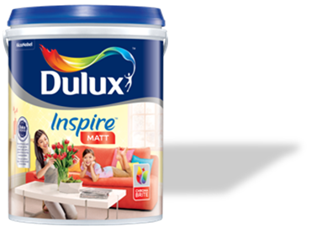
Introduction
Dulux Inspire Interior – Matt
ChromaBrite technology
Matt Finish
Long lasting protection
Notes:
VO: the Dulux Inspire Interior – Matt is an inexpensive option for getting that perfect matt finish on your walls. This also has the chroma bright technology which keeps walls looking fresher for longer. Lets check out its features in detail in the next slide.

Slide 46
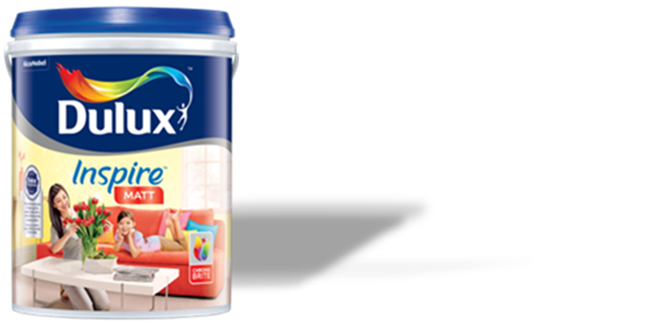
Features
Good Opacity
1 Ready mix
>2500 shades
Coverage:
10-12 mt²/Lt
mts²
Finish: Matt
1L, 5L & 18 L
Click the product to learn more.
Notes:
VO: Let's now check some features of this product.
Finishes with a Matt effect
Cover more space with less paint, with 10-12 square meters per liter.
Good Opacity to cover imperfections
Choose from over 2500 shares with a single
Available in 1, 5 and 18 litre packages.
Image Ref: https://www.freepik.com/free-photo/minimal-product-backdrop-with-wooden-cabinet_15667366.htm#query=wall%20with%20shelf&position=45&from_view=search&track=ais&uuid=03401b9d-5e02-493a-b83e-86ac6b56b47b

Slide 47
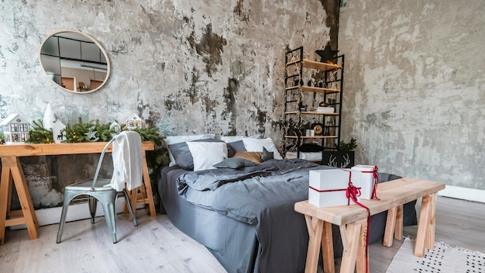
Bedroom 2
Notes:
VO: Bedroom 2 is where Adelia spends most of her time. She is fond of dark shades and want her room to reflect her personality. Let us see what Dulux has in store for her.
Image Ref: https://www.freepik.com/free-photo/room-interior-design_13195248.htm#query=dirty%20bedroom%20walls&position=14&from_view=search&track=ais&uuid=d55bd17b-2a77-49c5-a291-1810d9e0e545

Slide 48

Introduction
Dulux Inspire SmartChoice Interior
Affordable Choice
Good coverage
Better Opacity
Notes:
VO: Dulux Inspire SmartChoice Interior is a truly smart choice for Adelia’s bedroom. It is cost effective, gives good coverage and better opacity to hide the cracks and imperfections in the wall.

Slide 49
Good Opacity
1 Ready mix
>2200 shades
Coverage:
10-12 mt²/Lt
mts²
Finish: Matt
7L & 18 L
Click the product to learn more.
Notes:
VO: Let's now check some features of this product.
Finishes with a Matt effect
Cover more space with less paint, with 10-12 square meters per liter.
Good Opacity to cover imperfections
Choose from over 2500 shares with a single
Available in 7 and 18 litre packages.
Image Ref: https://www.freepik.com/free-photo/minimal-product-backdrop-with-wooden-cabinet_15667366.htm#query=wall%20with%20shelf&position=45&from_view=search&track=ais&uuid=03401b9d-5e02-493a-b83e-86ac6b56b47b

Slide 50
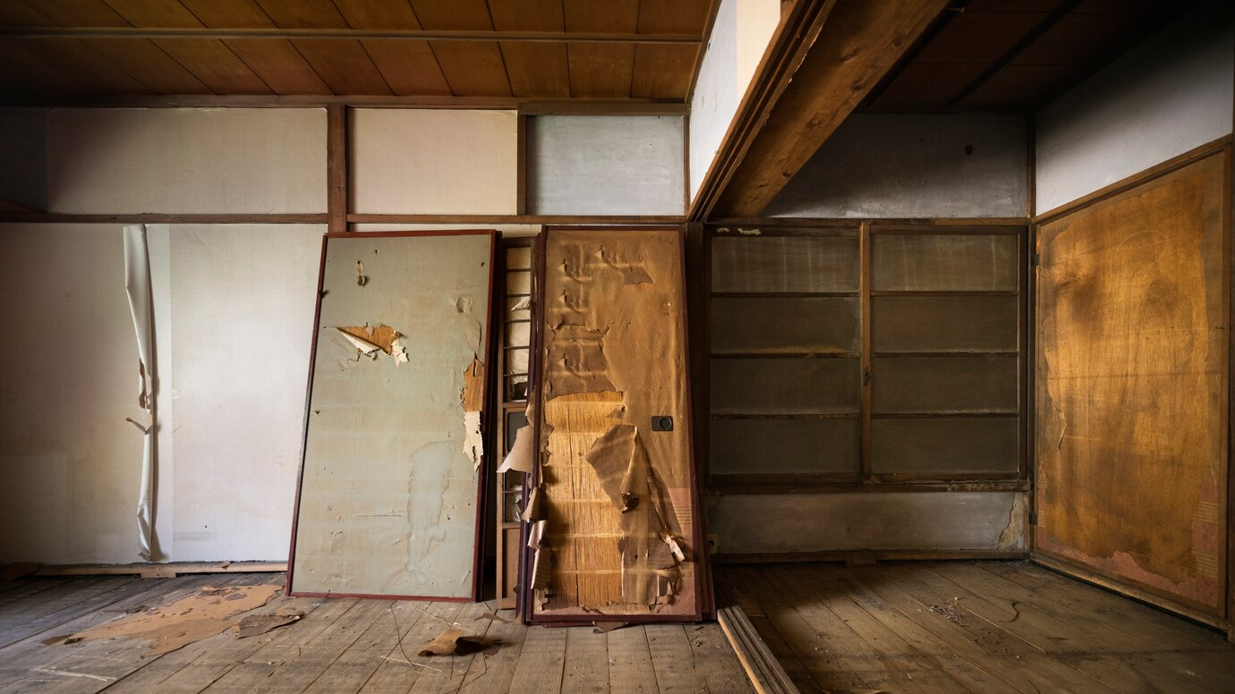
Attic
Notes:
VO: The attic is an area which needs a lot of repair. But as it is not used much, its often overlooked. Bintang wants to repair it and give it a cost effective solution to cover it up. Does Dulux offer any solution for such scenarios? Let’s find out.

Slide 51

Introduction
MAXILITE PLUS
Affordable Choice
Good coverage
Notes:
VO: Maxlite plus is one of the most cost effective paint solutions offered. Its Simple yet effective to give your often overlooked areas a fresh look. Let’s see its features next. Click Next. It has no added lead of mercury and is completely safe.

Slide 52
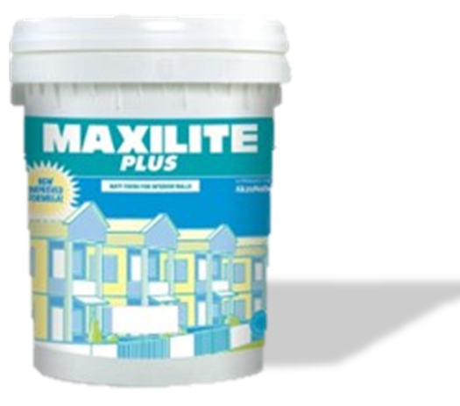
Basic Opacity
42 Ready mix
Coverage:
9 - 10 mt²/Lt
mts²
Finish: Matt
7L & 18 L
Click the product to learn more.
Notes:
VO: Let's now check some features of this product.
Finishes with a Matt effect
Cover more space with less paint, with 9-10 square meters per liter.
Basic Opacity to cover imperfections
Choose from over 42 Ready mix shades
Available in 7 and 18 litre packages.
Image Ref: https://www.freepik.com/free-photo/minimal-product-backdrop-with-wooden-cabinet_15667366.htm#query=wall%20with%20shelf&position=45&from_view=search&track=ais&uuid=03401b9d-5e02-493a-b83e-86ac6b56b47b

Slide 53
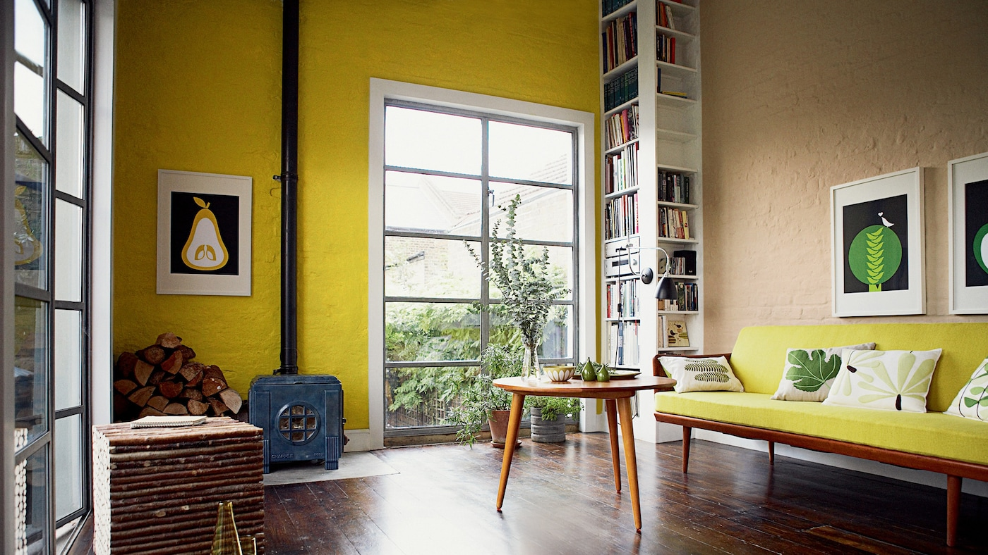
Results
Notes:
VO: Bintang and his cousins have found the best cost effective solution to give their uncles house a new makeover. Not only is his uncle happy with it, but they have great pride in doing the work themselves!
Image Ref: https://www.dulux.in/en/colour-inspiration/cut-through-neutrals-bright-bursts

Slide 54
Which of the following has the maximum paint coverage per litre of product?
1
2
Inspire SmartChoice Interior
Inspire Interior – Smooth Sheen
3
4
Maxlite Plus
Inspire Interior – Glow
Notes:
Developer Notes: Option 1 is the correct choice. Inspire SmartChoice Interior has 10-12 sq. mts of coverage per litre, while the others have 10-11 sq. Mts/Litre

